Slide 1

Machine Learning final project
Fall Term - 2022
Presented by Antony Garcia

Slide 2

Main Objective
Build a software tool for building training and testing datasets
Use the developed tool to build datasets for training and testing Machine Learning models
Develop an accurate ML model for fire detection

Slide 3
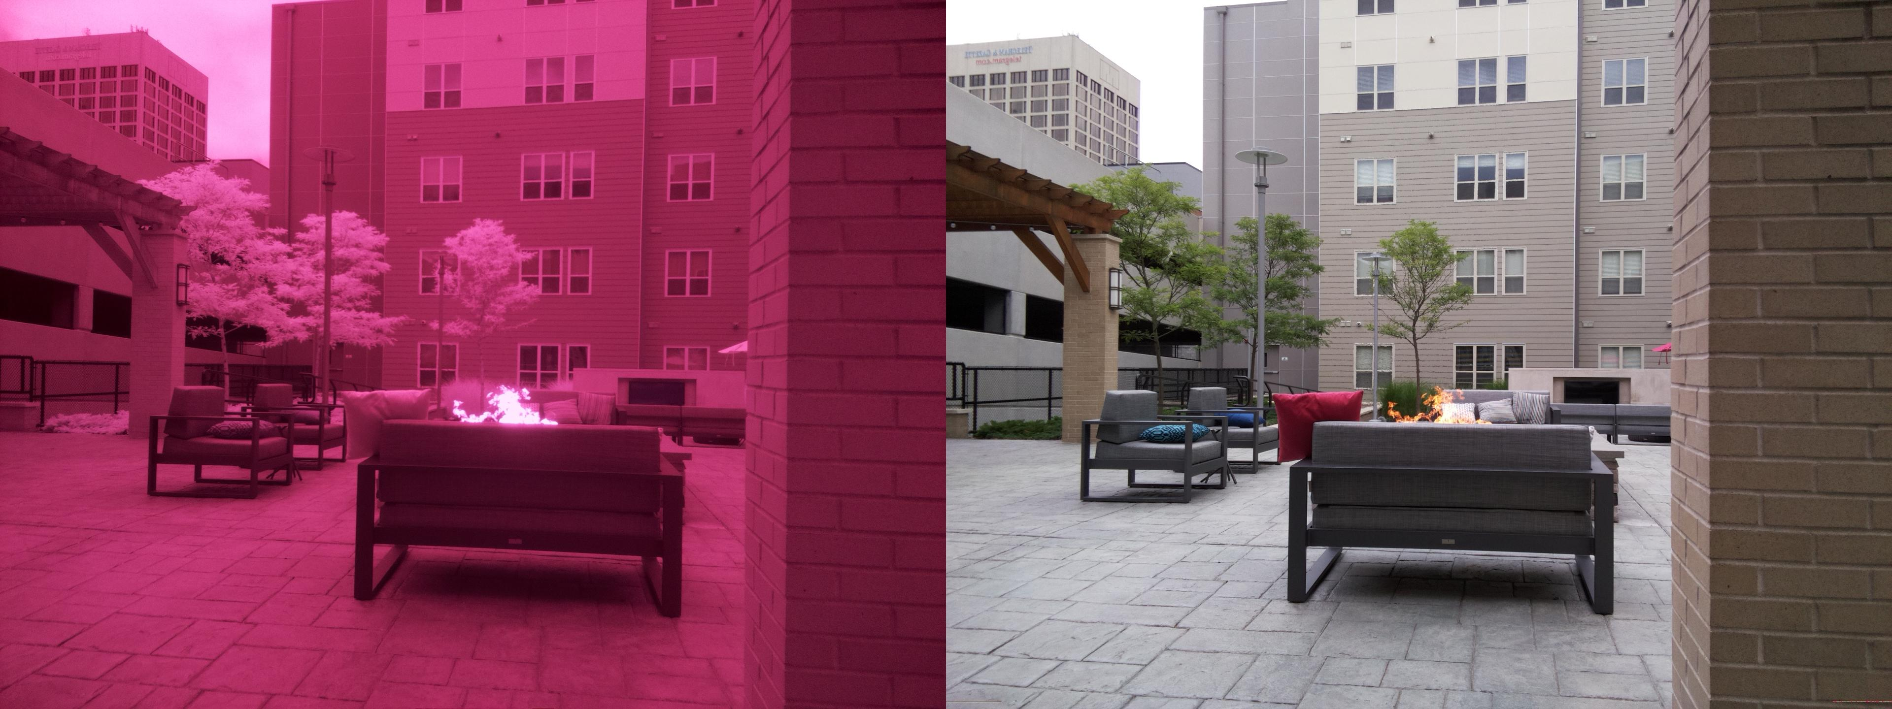
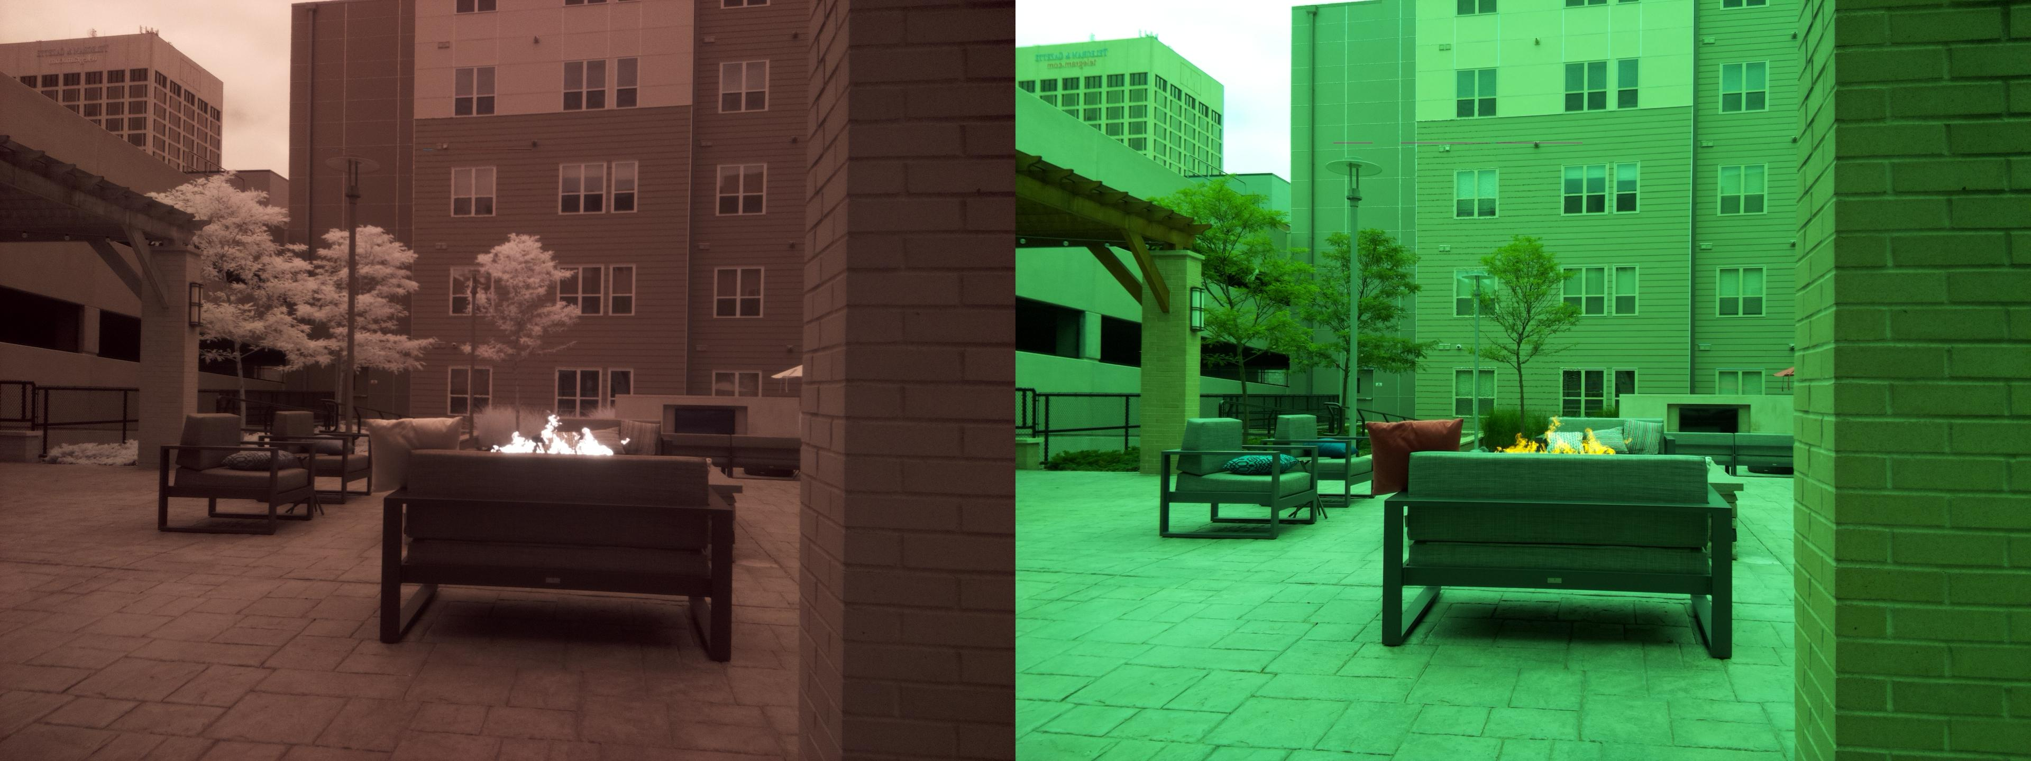
Original dataset

Slide 4
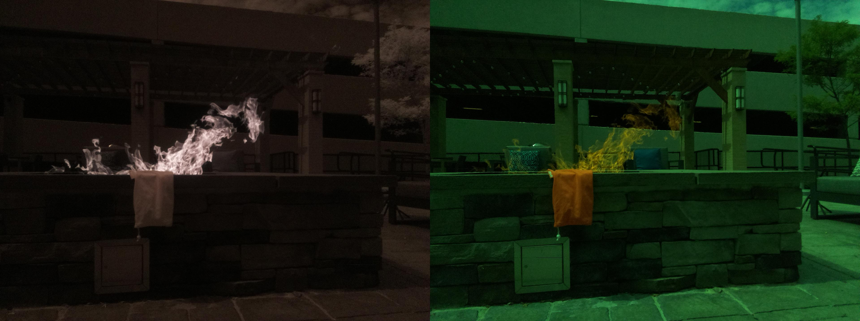
Original dataset

Slide 5
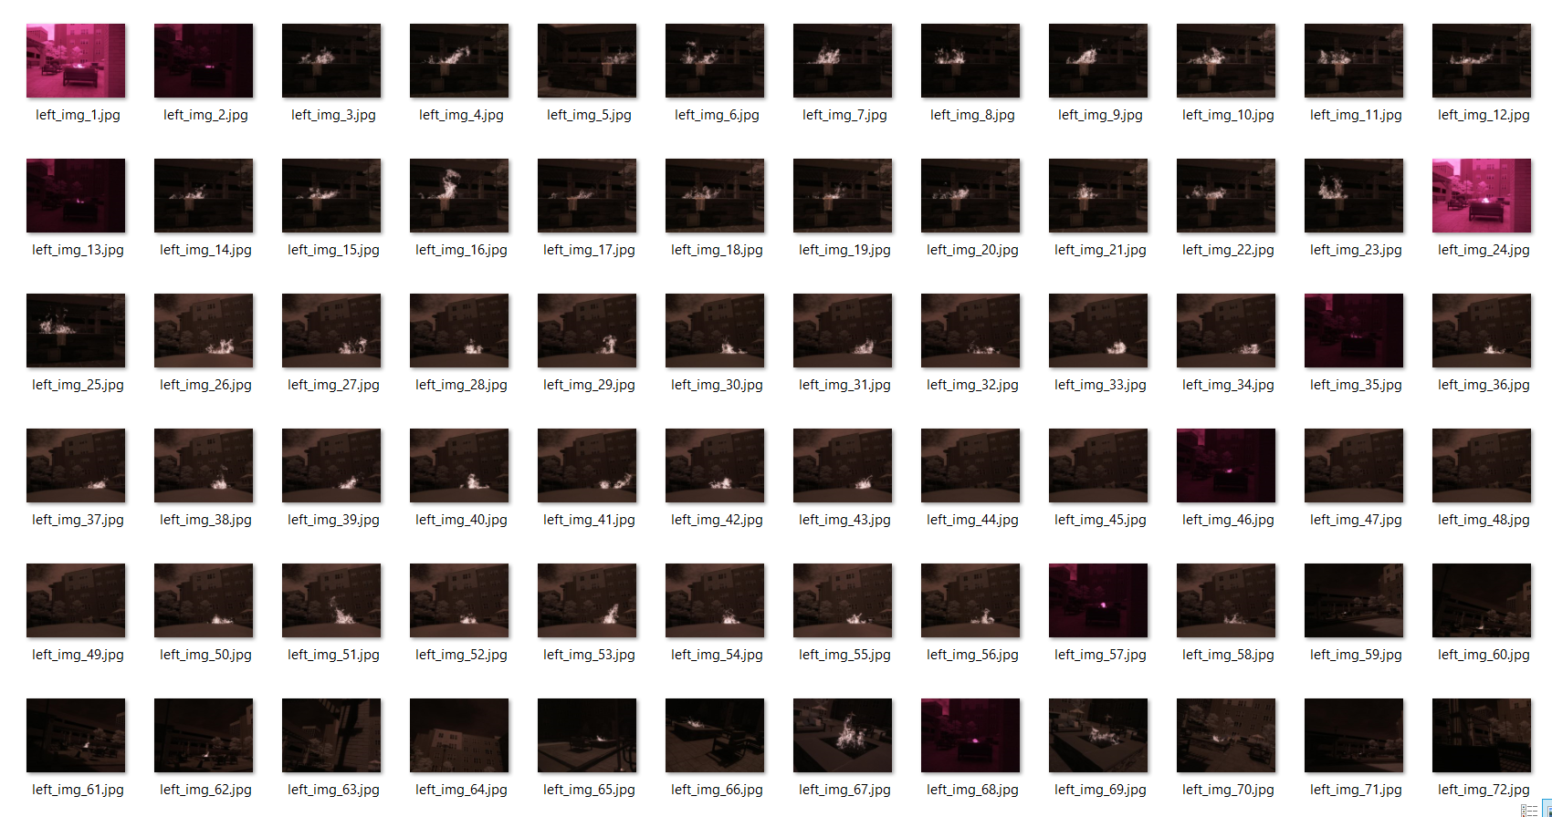
Split images

Slide 6
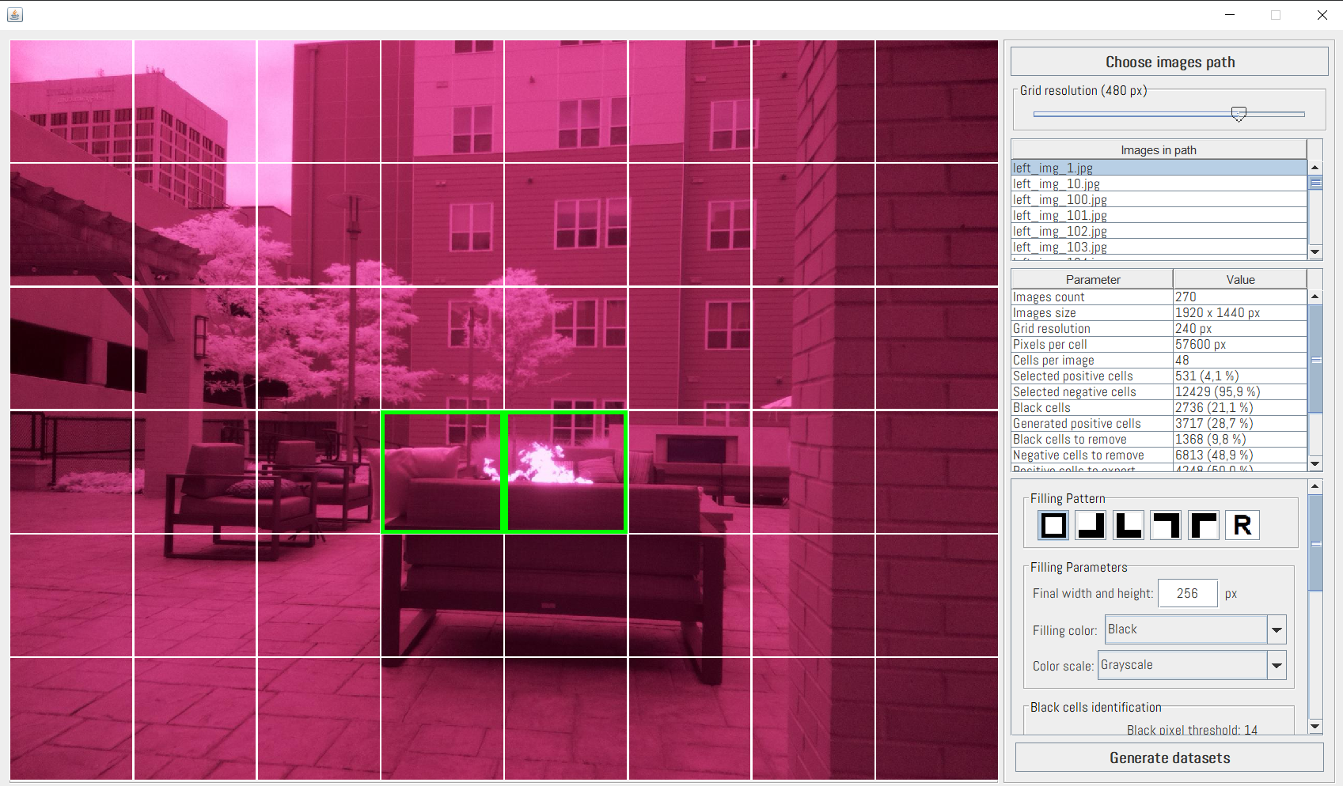
Frame selection interface

Slide 7
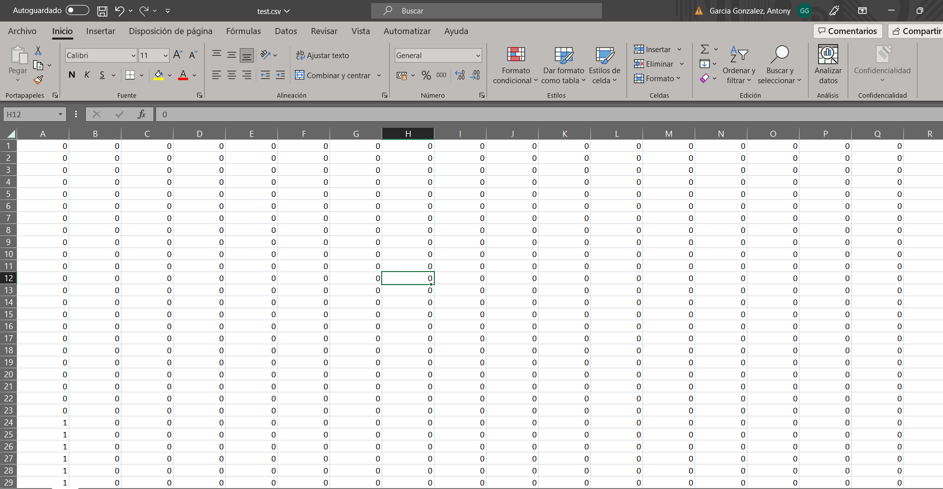
Images converted to pixels in csv

Slide 8
Images converted to pixels in csv
The datasets were formatted just like MNIST dataset. Instead of 784 columns (28x28 pixel images of MNIST), the testing and training datasets have 65536 columns (256x256 images)
The same algorithms that were tried with MNIST in the homeworks were tested with the obtained datasets

Slide 9
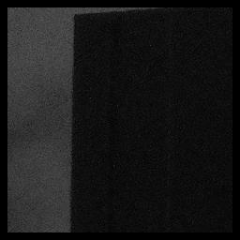
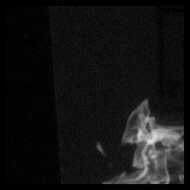
Images converted to pixels in csv
At first it was considered that some Deep Learning model was needed for this task, so frames should be resized to 256x256 pixels. This was done by adding black pixels around the frame.

Slide 10
Images converted to pixels in csv
The way the classifier algorithm is built, every time it is run it creates a different dataset.
With selected export parameters, training dataset has 5476 frames and testing dataset has 1728. This is around 80%-20% proportion

Slide 11
Results
Gaussian Process Classifier did not provide good results. Training time was too high and the laptop ran out of memory while trying to train the model.

Slide 12
Results
The second test was performed with Random Forest Classifier, with a testing accuracy of ~65%.
The first try was done with a datasets built from a “pool” of positive and negative frames
This means, all frames were put in a pool, some percent of them were classified as “testing frames” and other “training frames”, without considering the original image they came from

Slide 13
Results
In order to try algorithms other tan Random Forest and being able to correctly evaluate the outcome, I changed the dataset generating algorithm to separate images rather tan frames.

Slide 14
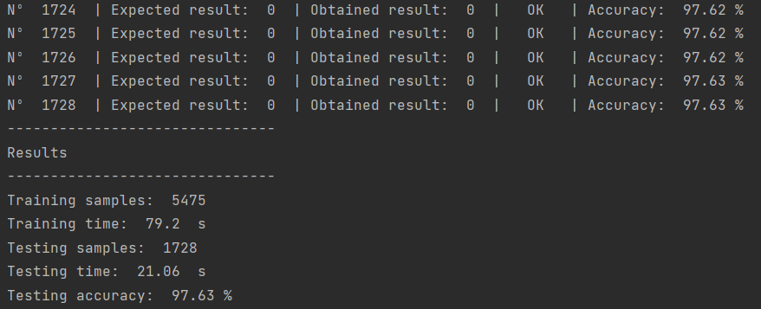
Results
With the new procedure to separate images in datasets, the accuracy of the classifying algorithm improved.
With Random Forest Classifier, an ~97% accuracy can be reached

Slide 15
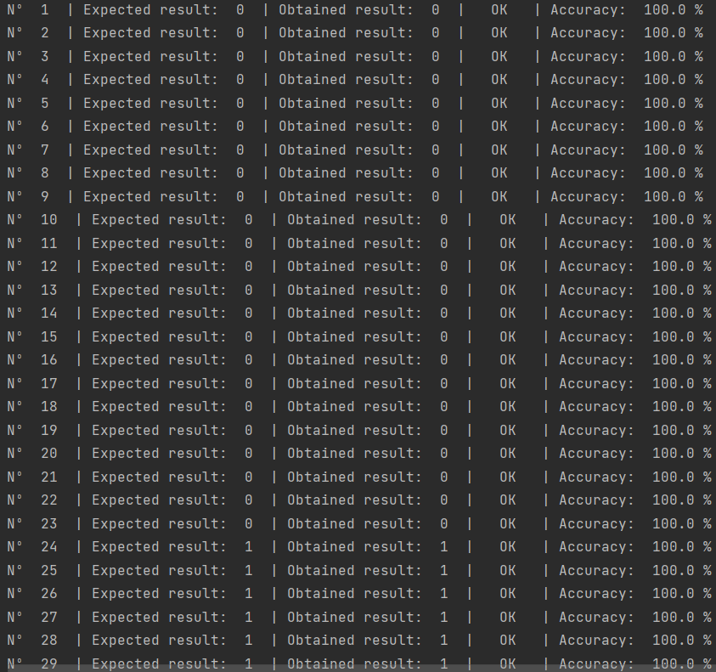
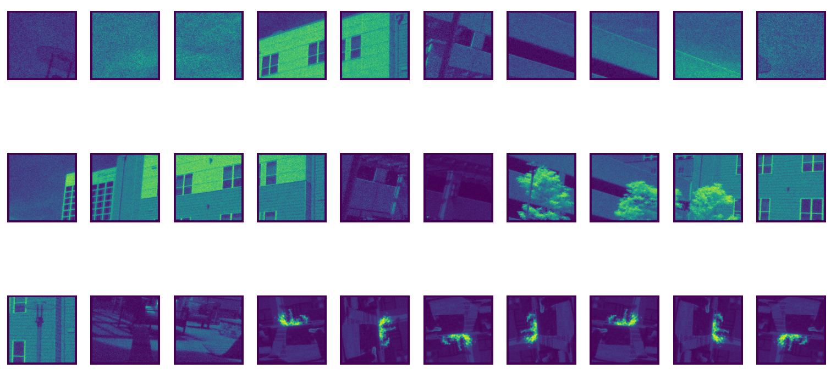
Results

Slide 16
Results
Other algorithms were tested, like Support Vector Machines, but resulted to be slower when training and testing. Training time for SVM was more tan 4 times higher tan Random Forest. Accuracy was slighty better, around 98%.
With Random Forest I have a training time of about 80 seconds and testing time of ~25 seconds. These results were obtained with CPU and no GPU.

Slide 17
Results
No hyperparameter tuning was performed, as the Random Forest model was accurate enough for this task. We have to take into consideration that a single image can have multiple frames with fire, so it is not neccesary to detect all frames with fire.

Slide 18
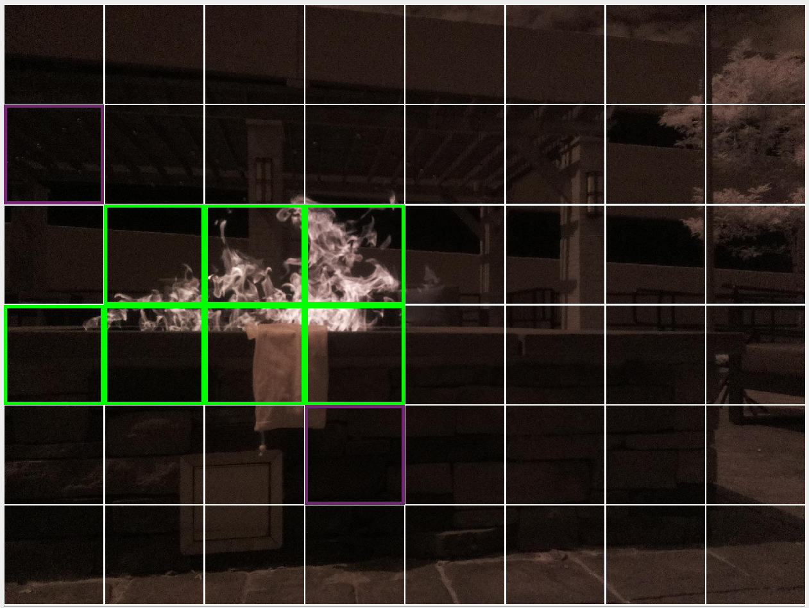
Results
The overall accuracy of the algorithm Will be much higher when tested in images rather tan frames. Random Forest can classify frames with ~97% accuracy, but an image can have multiple frames with fire, so there are many chances to detect if there is or there isn’t fire in the image.

Slide 19
Thanks for your attention

